Slide 1
Personalizing Dialogue Agents via Meta-Learning
ACL 2019
Lin et al.

Slide 2
Outline
Introduction
Motivation
Method
Experiment
Conclusion

Slide 3
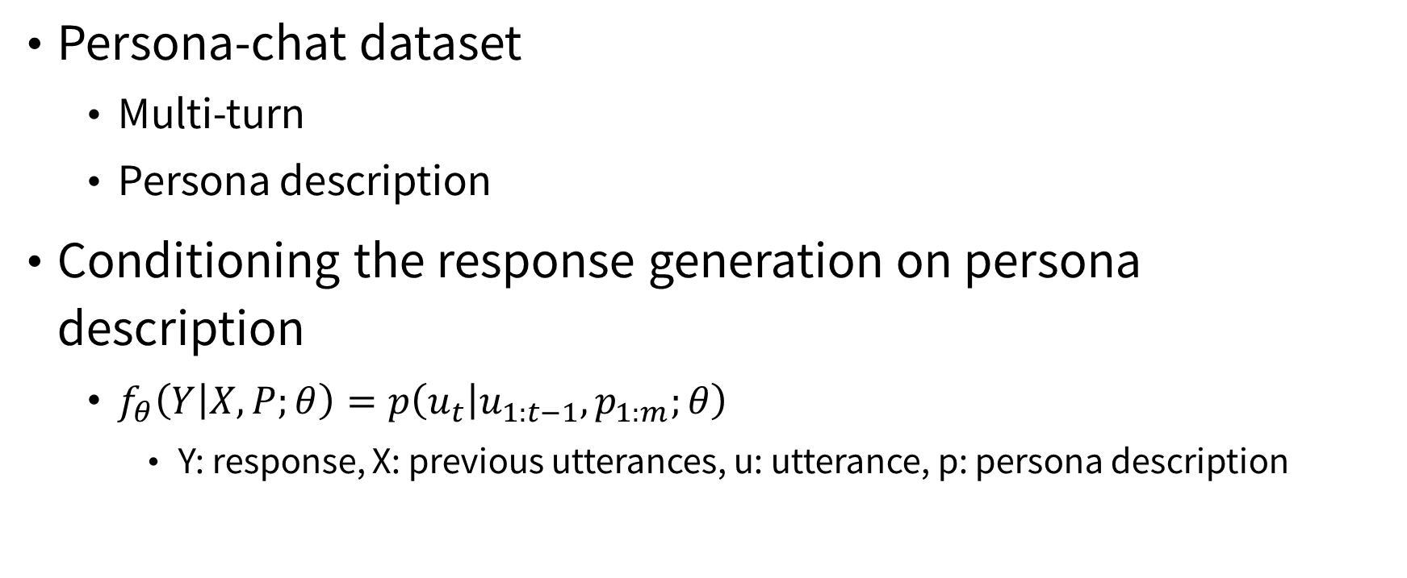
Introduction
Back to Outline
Persona-chat dataset
Multi-turn
Persona description
Conditioning the response generation on persona description
$f_{θ}\left(Y | X,P;θ\right)=p\left(u_{t} | u_{1:t−1},p_{1:m};θ\right)$
Y: response, X: previous utterances, u: utterance, p: persona description

Slide 4
Introduction
Back to Outline
（Examples of dialog in the appendix of the paper）

Slide 5
Motivation
Back to Outline
Human designed persona descriptions
Expensive
Requires hand-crafted feature
Collecting a non-synthetic set of persona descriptions from a real human-human conversation, e.g., Reddit, is challenging.
Aim
Persona-independent model
Quickly adapt to a new persona given the dialogues.

Slide 6
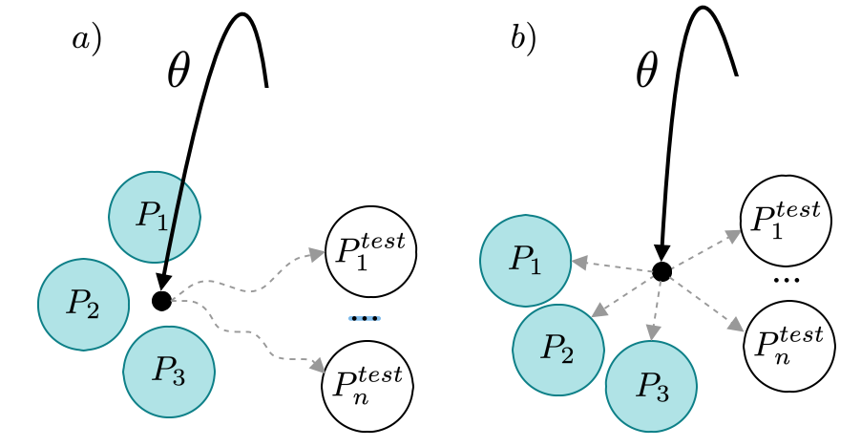
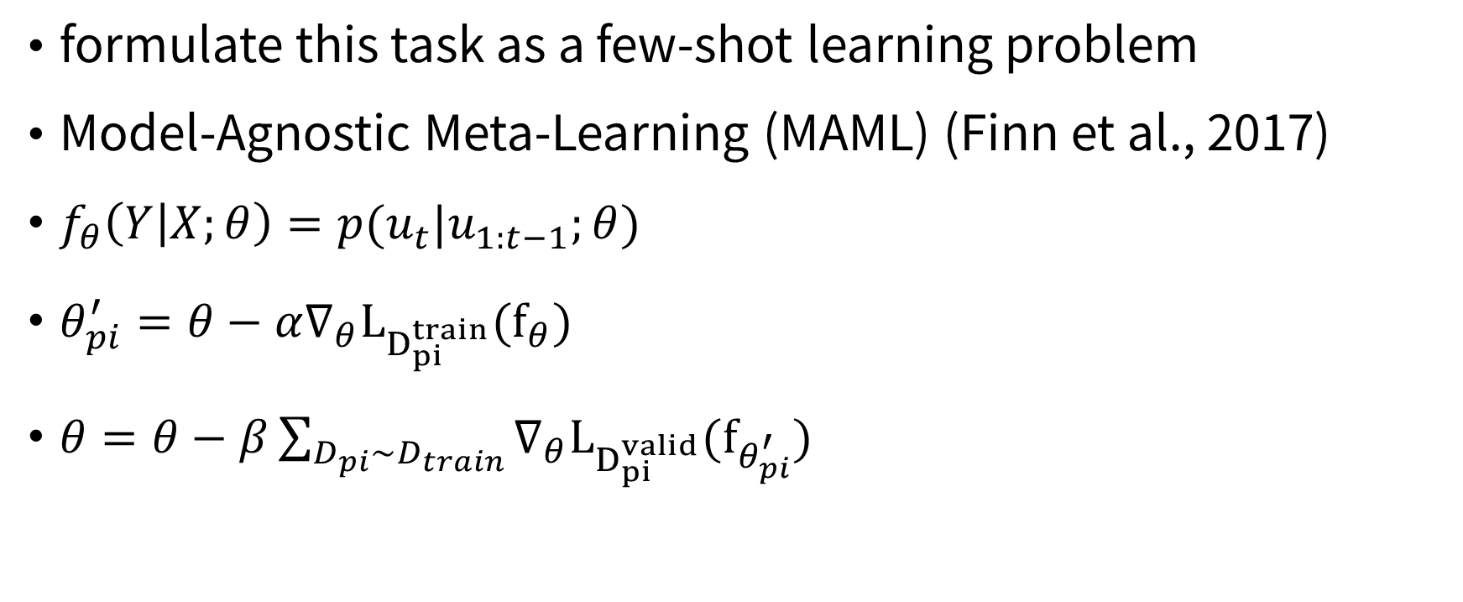
Method
Back to Outline
formulate this task as a few-shot learning problem
Model-Agnostic Meta-Learning (MAML) (Finn et al., 2017)
$f_{θ}\left(Y | X;θ\right)=p(u_{t}|u_{1:t−1};θ)$
$θ_{pi}^{′}=θ−α∇_{θ}L_{D_{pi}^{train}}(f_{θ})$
$θ=θ−β\sum_{D_{pi}∼D_{train}}{∇_{θ}L_{D_{pi}^{valid}}(f_{θ_{pi}^{′}}) }$

Slide 7
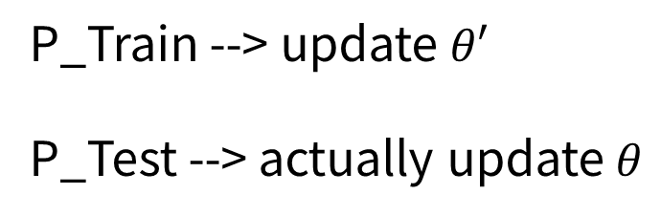
Method
Back to Outline
P1
P2
Pi
Pz-1
Pz
P_Train --> update $θ′$
P_Test --> actually update $θ$
Train
Valid
Test
Dataset

Slide 8
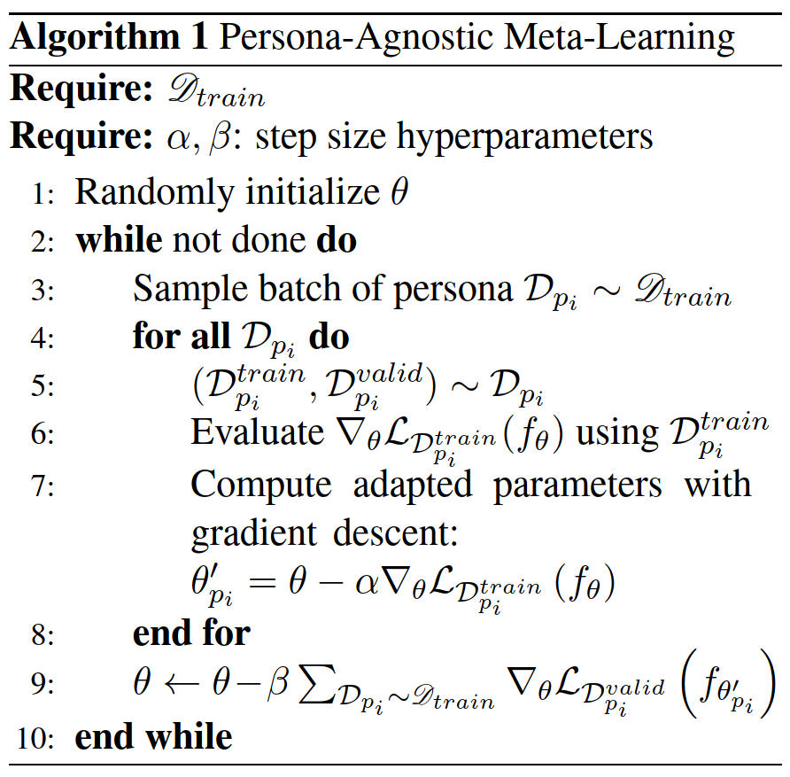
Method
Back to Outline

Slide 9
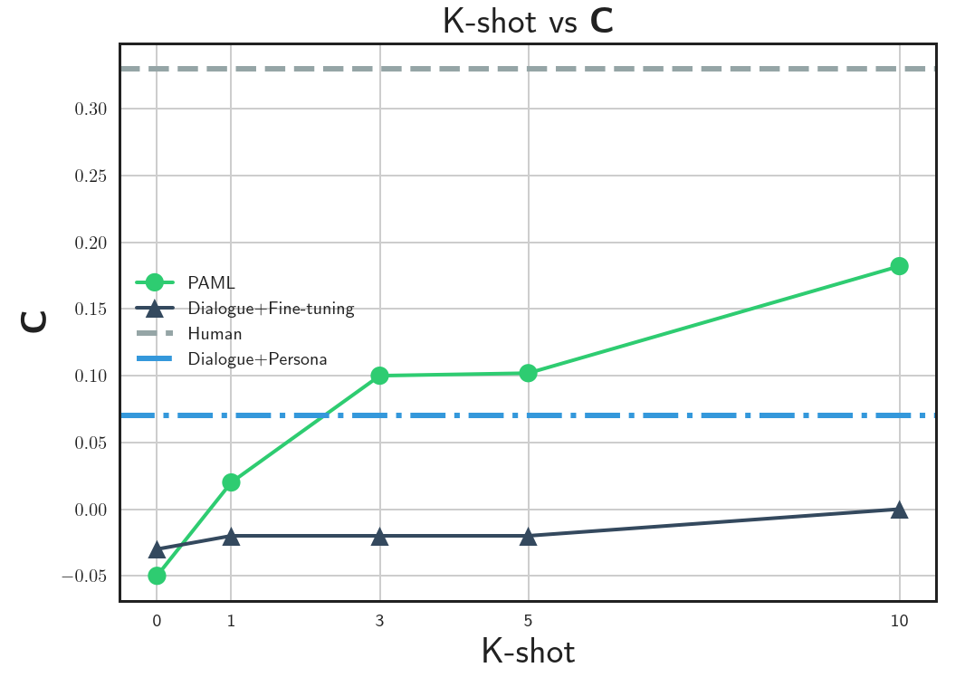
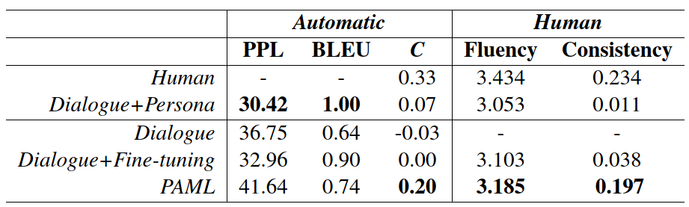
Experiment
Back to Outline
Evaluation metric
Perplexity, BLEU, Natural Language Inference (NLI)
Fluency (1 to 5), consistency ({-1, 0, +1})

Slide 10
Conclusion
Back to Outline
meta-learning setting
without conditioned on the persona description
more consistent (automatic and human)
(LLJ: The generated responses samples in Appendix are not so persuasive.)

